Slide 1
BIG MOUNTAIN RESORT PRICING RECOMMENDATIONS
By Timothy Lu
May 20th 2022

Slide 2
PROBLEM IDENTIFICATION
Big Mountain Resort is looking to increase profits and maximize the efficiency of its facilities.
The Resort should aim to justify raising its ticket prices by 10% by the end of the season.
We want to make sure our price increase is based on a pricing models based on facilities data which shows Big Mountain can offer more than other resorts and can charge an appropriate price.
Current Price: $81.00
Goal Price: 10% Increase
$89.00

Slide 3
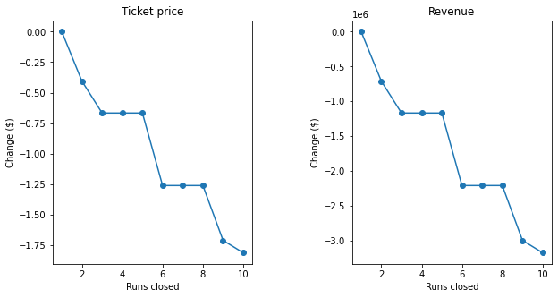
RECOMMENDATION AND KEY FINDINGS
We found two potential solutions to either decrease runs to lower operational costs or to increase the facilities we have to offer in order to justify a ticket price increase
Option 1 - Reduce Runs
We can see that reducing runs could potentially cause ticket price decreases but the trade-off is lowered operational costs.
Reducing runs by 1 or 2 may make minimal impact compared to the amount of ticket price decrease. Reducing by 5 runs may make significant operational cost decreases without impact ticket price.
Option 2 - Increase Facilities
Another option is to make the following facilities changes:
Add an additional run
Increase our highest vertical drop by 150 ft.
Increase our total chairs by one
Inputting these changes into the model showed support for an increase in ticket price by $8.61 which ultimately leads to an overall revenue increase of $15,065,471 over the course of the season.

Slide 4
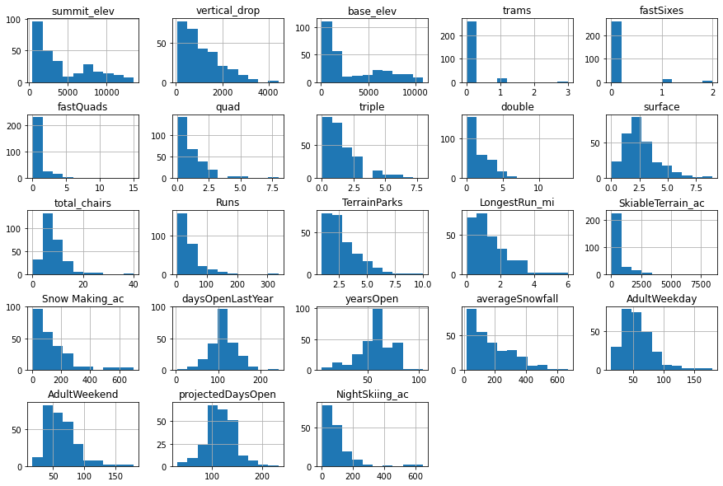
Data Analysis - Cleaning and Organizing
We prepared the data by doing the following:
We decided our target feature is adult weekend prices as that would best capture our pricing model
We removed the fastEight column as most resorts did not have a fastEight or the data was missing from resorts
We removed resorts that did not have their ticket prices as they would not be useful for modeling ticket prices
Corrected some minor data errors namely, the skiable area for a resort in Colorado was wrong and one resort whose resort age was incorrectly input as the year 2019
We looked at the distributions of data to visually understand what features may be useful to explore

Slide 5
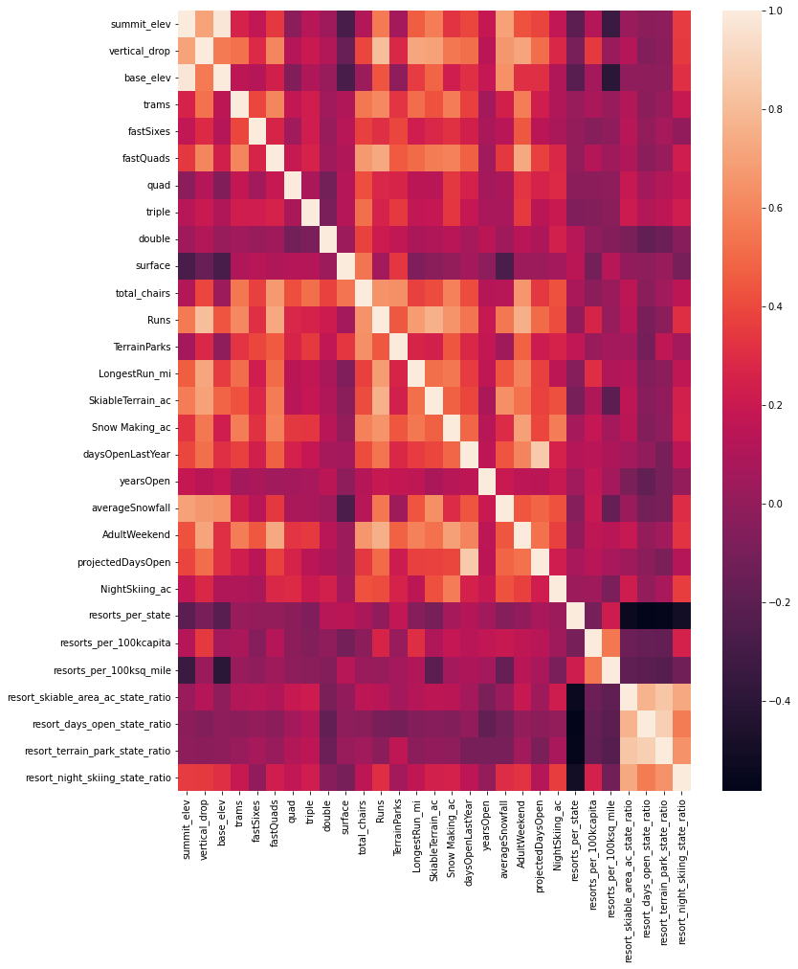
Data Analysis - EDA
Performing PCA on state-wide data showed that there were two primary components which contributed heavily to the variance in ticket prices on a statewide level. These included resorts per state and skiable area.
We chose to explore the data on a resort-level and understand the features that best correlate with ticket prices. Through a correlation heat map, we discovered the following features that are most correlated with ticket price:
fastQuads, Runs, Snow Making area (in acres), total chairs
Moving forward, we will be focusing on these features
as the primary drivers for our model

Slide 6
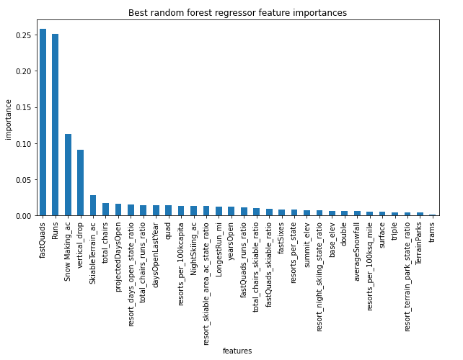
Data Analysis - Training and Modeling
Through comparing linear regression models and random tree models we ultimately decided that a random tree model would be the best estimator as it has the most generalizability and need variance through various test sets.
We utilized cross-validation and grid search CV to fine tune some of the hyperparameters (best parameters, optimal number of trees) to find the best model. Through this, we trained a model for predicting ticket prices for the resort.
We ran the model on the resort data and predicted that Big Mountain is underpricing itself and that there should be room for an increase from the original of $81.00 to around $95.87 even with an error of $10.39 there is room for an increase.

Slide 7
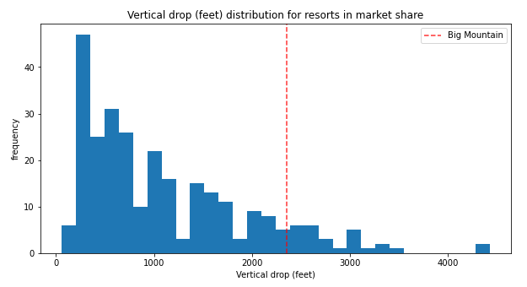
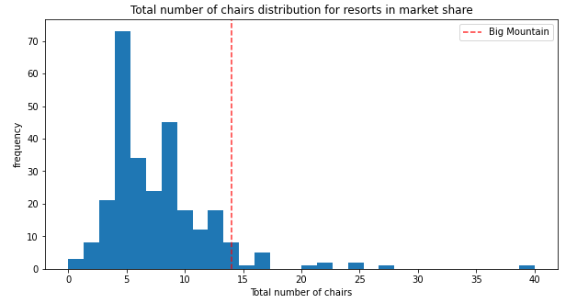
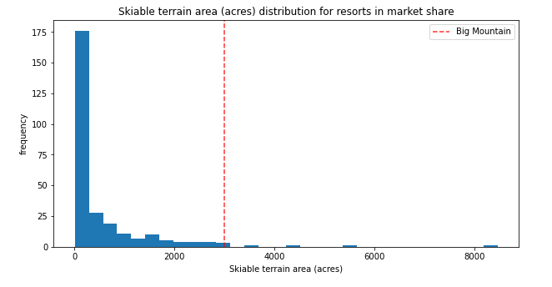
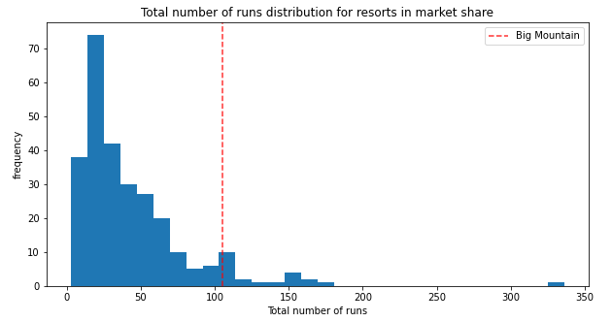
Data Analysis - Training and Modeling
This increase is based on the market context of Big Mountain Resort being on the upper range of the most important features of vertical drop, skiable area, runs, and total chairs, we can make an argument for the increase.
This same model was used to predict price changes for decreasing the number of runs as we wanted to consider potential cost-savings to improve revenue. We looked at how decreasing runs would impact our ticket pricing and the results were shown earlier.

Slide 8
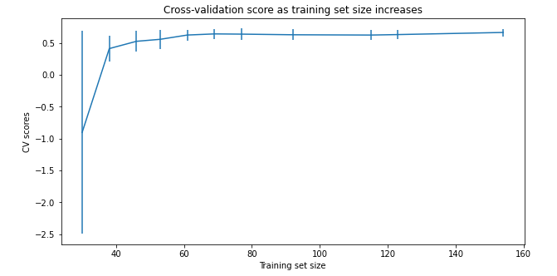
Conclusion
We are confident in our model in its current state but we feel with more data we could create a better model. The current training set size is adequate but what would really improve the model is data we find critical such as:
Operational costs by facility
More ticket prices from other resorts
Visitor data for more accurate price forecasting
We may also want to double-check the values of other resorts. There is some concern that other resorts may be undervaluing themselves. Big Mountain has a lot of its facilities in the upper range and yet is priced at the median range. We should investigate what other features may impact pricing (such as tourism attractiveness) and try to incorporate those into the model.

